Slide 1
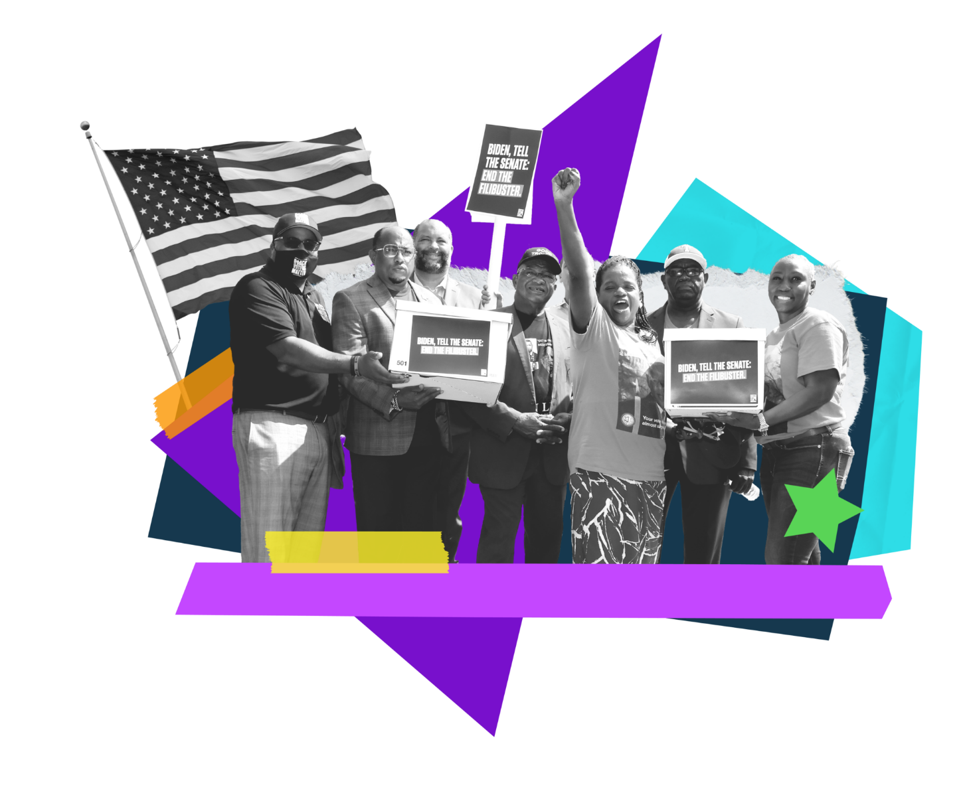
Guaranteeing Voting Rights for All: Analysis of Survey Findings
September 2022
Daniel Gotoff
Celinda Lake
McCauley Pugh
Sandra Markowitz
Ronan Ferrentino

Slide 2
Methodology
_{Methodology}
State Innovation Exchange/Stand Up America/Sentencing Project/Common Cause commissioned Lake Research Partners to conduct a nationwide survey on full restoration of voting rights to all citizens, including those completing sentence, both inside and outside of prison, as well as a series of in-depth interviews among people who were formerly incarcerated.
LRP designed and administered the survey, which was conducted online, reaching a base sample of 1,000 likely 2022 General Election voters nationwide, as well as oversamples of 200 likely voters in Illinois, Nevada, New York, North Carolina, and Oregon. The survey was conducted July 11-17, 2022. The margin of error for the base sample is +/-3.1% and larger for subgroups. Respondents were recruited for the sample from an online panel. The data were weighted slightly by gender, age, race, region, education level, and ideology.
Lake Research also conduct in-depth, one-on-one interviews with seven individuals who were formerly incarcerated, from across the country, including a mix of gender, race, age, and area of the country. Participants were recruited by word of mouth through partners and via recruiting firm, and interviews were conducted over the course of several weeks between May 17th and June 2nd, 2022.
In opinion research, qualitative research seeks to develop insight and direction rather than quantitatively precise or absolute measures. Because of the limited number of respondents and the restrictions of recruiting, this research must be considered in a qualitative frame of reference. This type of research is intended to provide knowledge, awareness, attitudes, and opinions about issues and concerns, rather than considered reliable or valid in the statistical sense.

Slide 3
Key Findings and Impact of the Data
While there have been several public national and state-wide studies examining re-enfranchisement, our research is distinct in its specific framing of guaranteeing the right to vote for all Americans, regardless of how they may be impacted by the criminal legal system.
Additionally, these findings are truly remarkable and something to celebrate - the data reveals majority support for re-enfranchisement when it’s framed as guaranteeing the eligibility to vote for all citizens 18 and older, including citizens completing their sentence, both inside and outside of prison.
Including “felony” drops support, but even in that iteration, a full half of voters support it. In the current political atmosphere and largely one-sided “discourse” on criminal legal reform, this is a striking—and encouraging—finding.
We also tested messaging to further engage on the issue and found that focusing on disenfranchisement as denying citizens the ability to fulfill their civic obligation to our democracy tests the best with voters, as well as messaging talking about community safety and community connection.

Slide 4
A majority of voters supports a law guaranteeing the eligibility to vote for all citizens 18 and older, including citizens completing their sentence, both inside and outside of prison. When proposal language refers to “felony convictions”, support drops to fifty percent and the margin separating support and opposition narrows.
Initial Ballot
With Felony Convictions
Completing Their Sentence
+22
+9
Q16/21 Would you support or oppose a law that guarantees the eligibility to vote for all citizens 18 and older, including citizens (with felony convictions)/(completing their sentence,) both inside and outside of prison?
Notes:
Change title

Slide 5
Engaged Debate Statements
SUCCESSFUL RE-ENTRY FRAME | REDRESSING DISPARITIES FRAME
[PRO-UNIVERSAL VOTING RIGHTS] All citizens of this country should have a say in what happens in their community, and a voice in their government. The right to vote is enshrined in our constitution and fundamental to our freedom as Americans. But 5.2 million people in the U.S. are currently denied their right to vote because of a felony conviction. Research shows that people who’ve been incarcerated are less likely to be convicted again if they return to their communities and can work jobs, raise families, pay taxes, and feel connected and invested in the future. Being able to vote—and have a say in the decisions that impact your family and loved ones, like roads, schools, and hospitals—encourages people to reenter society and have a stake in their communities. | [PRO-UNIVERSAL VOTING RIGHTS] All citizens of this country deserve to have a say in what happens in their community, and a voice in their government. The right to vote is enshrined in our constitution and fundamental to our freedom as Americans. 5.2 million people in the United States are currently denied access to vote because of a felony conviction. Biases in the criminal legal system mean that poor people, Black people, and other people of color are more likely than others to be convicted of crimes and to lose their voting rights, while wealthy people can always afford the best lawyers. To realize the promise of American democracy and address significant racial inequities, states must pass universal voting for people impacted by the criminal legal system.
[ANTI-UNIVERSAL VOTING RIGHTS STATMENTS]
Notes:
Change title

Slide 6
Simulating supporters and opponents engaging a debate over full re-enfranchisement results in a much more divided electorate.
Profile Ballot – Successful Re-entry
Profile Ballot – Redressing Disparities
+3
-8
Q30/31. Next, you will read two short statements about voting. After reading both statements, please indicate which of two statements is closer to your own point of view even if neither is exactly right. [ROTATE.]
Notes:
Change title

Slide 7
After voters hear further messaging in support of re-enfranchisement, support picks back up to original levels.
Final Ballot Analysis
Final Ballot – With Felony Convictions
Final Ballot – Completing Their Sentence
+8
+16
Q35/40. And one more time, would you support or oppose a law that guarantees the eligibility to vote for all citizens 18 and older, including citizens (with felony convictions)/(including citizens completing their sentence,) both inside and outside of prison?
Notes:
Change title

Slide 8
The top phrase that voters feel describe guaranteeing the eligibility to vote for all citizens 18 and older, including citizens completing their sentence, both inside and outside of prison are “guaranteeing the right to vote”, “restoring the right to vote”, and “restoring the freedom to vote”. For voters who have been involved in the criminal legal system, “guaranteeing the right to vote” and “universal voting rights” are the top phrases. “Ending Jim Crow voting bans” and “universal suffrage” test the worst.
Best phrase for guaranteeing the eligibility to vote for all citizens 18 and older, including citizens completing their sentence, both inside and outside of prison
% well for those involved in criminal legal system
73%
68%
71%
70%
73%
66%
70%
60%
50%
48%
Q26. As you may know, in many states, felony convictions can trigger a loss of voting rights. Below is a list of phrases some people have used to describe guaranteeing the eligibility to vote for all citizens 18 and older, including citizens completing their sentence, both inside and outside of prison? Please indicate how well that phrase describes the concept. [RANDOMIZE]
Notes:
Change title

Slide 9
Our top messages frame voting as an obligation and a duty for every citizen that cannot and should not be taken away and goes on to argue that denying Americans the ability to vote not only denies a right, but denies them the ability to fulfill their civic obligation to our democracy. Other messages that are broadly persuasive underscore restoring voting rights as a key component of successful (re)integration into communities, reducing the likelihood of people returning to prison and improving public safety for all.
Messages
Q34. Now you will read some statements people have made in support of a law that guarantees voting eligibility for all. Please indicate whether each statement, assuming it is true, is a VERY convincing, SOMEWHAT convincing, NOT TOO convincing, or NOT AT ALL convincing reason to support that law. [RANDOMIZE]

Slide 10
Top Tier Messages
STATEMENT- Full text | % very convincing (%total)
[VOTING OBLIGATION] Every citizen of the United States has an obligation and a duty to vote. Voting is a right that cannot and should not be taken away from any citizen of the U.S. No matter your race, area code, or income, every American has an equal say in what happens in our country and our community. Denying Americans the ability to vote not only denies a right, but it denies them the ability to fulfill their civic obligation to our democracy. | 30% (59%)
[COMMUNITY CONNECTION] The majority of incarcerated people will re-enter society after completing their sentence and work jobs, raise families, and pay taxes in their communities. Making sure they can vote while incarcerated allows them to feel involved in their communities, and increases the success of reintegration when they come back. Voting also allows incarcerated people to advocate for their children and loved ones who remain in their communities. All Americans should have the ability to advocate not only for themselves, but for the people they love. | 23% (54%)
[COMMUNITY SAFETY] It is in everyone’s interest that those released from incarceration become successfully integrated into our communities. Study after study has shown that successful re-entry greatly reduces the likelihood of people returning to prison, and improves public safety for all—that includes ensuring people can support themselves and their families through work and can become engaged and active in their communities. Guaranteeing the right to vote for all Americans, including those who are incarcerated, keeps citizens involved in their communities and makes our communities safer. | 26% (63%)
Sorted by % Very Convincing

Slide 11
Second Tier Messages
STATEMENT- Full text | % very convincing (%total)
[JIM CROW – HISTORY] Like poll taxes and literacy tests, laws that block people with felony convictions from voting are Jim Crow relics explicitly designed to deny voting rights to Black Americans. After the Civil War, states moved to strip Black citizens of their new voting rights. Today, these anti-voter laws continue to disproportionately target Black Americans and other communities of color. Guaranteeing the right to vote to all Americans, including those who are or have been incarcerated, makes sure all Americans have a voice in our Democracy. | 23% (50%)
[WE THE PEOPLE] Our constitution guarantees free elections, equal protection under the law, and freedom of speech. Voting is also fundamental to our rights and freedom as Americans. Everyone, including people who are incarcerated, should have access to the ballot box so they can have a say in the decisions that impact their lives. The “we” in “We the People” should truly include all Americans, including citizens who may be completing a sentence, both inside and outside of prison | 23% (52%)
[MASS INCARCERATION/ REPRESENTATION - CLASS] Due to biases and inequities in our criminal legal system, poor people are more likely to be incarcerated than their wealthier counterparts. For many people, life after prison only means partial citizenship, as formerly incarcerated people often experience limited opportunities for employment, housing, and voting. As we work to reimagine our criminal legal system to be more fair and equitable, one of the first changes we can make is to restore voting rights to people who are most impacted by that system, inside and outside prisons. | 23% (50%)
[JIM CROW - NUMBERS] Blocking people with felony convictions from voting started in the Jim Crow era as an intentional strategy to keep Black people from voting because they are disproportionately impacted by the biased criminal legal system. Black Americans are incarcerated in state prisons at nearly 5 times the rate of white Americans. This racist strategy still impacts much of the country today. Guaranteeing the right to vote to all Americans, including those who are or have been incarcerated, makes sure all Americans have a voice in our Democracy. | 22% (50%)
Sorted by % Very Convincing

Slide 12
Third Tier Messages
STATEMENT- Full text | % very convincing (%total)
[MASS INCARCERATION/ REPRESENTATION - RACE] Due to biases and inequities in our criminal legal system, people of color are more likely to be incarcerated than their white counterparts. For many people, life after prison means partial citizenship, as formerly incarcerated people often experience limited opportunities for employment, housing, and voting. As we work to reimagine our criminal legal system to be more fair and equitable, one of the first changes we can make is to restore voting rights to people who are most impacted by that system, inside and outside prisons. | 22% (50%)
[SOCIETY STRONGER] Mass incarceration damages our communities, whether we’re Black, brown, or white, in many ways. It divides families, harms children, and steals resources away from other community needs. To reverse that harm, we need to keep people from re-entering the criminal legal system. We know that civic engagement reduces the likelihood that someone returns to prison again because they feel connected to their community. By restoring voting rights to incarcerated people, we can reduce recidivism and make our society stronger. | 22% (52%)
[ELECTIONS/ STACKED DECK] Some politicians see taking away people’s freedom to vote as a way to keep more power for themselves. By blocking incarcerated people from voting, knowing that people of color are prosecuted more often, they hope to silence certain communities’ voices. Our elections cannot be considered free and fair when large numbers of citizens are denied their freedom to vote. Allowing all citizens in our communities to vote gives Americans who are directly impacted by our criminal legal system a valued voice in our democracy. | 22% (49%)
[RACIALIZED CAPITALISM] Incarceration and the prison industrial complex make billions of dollars across the country every year, and many people who are incarcerated work low or no-paying jobs to benefit others, like fighting wildfires. The prison system dehumanizes those who move through it rather than helping them, and strips away many basic rights that every American is guaranteed. Ensuring that all citizens can vote restores some of the dignity that is stripped away by an unjust and dehumanizing system. | 21% (51%)
Sorted by % Very Convincing

Slide 13
_{Future Areas of Research}
Although our study resulted in a number of exciting findings, we believe this should only be the beginning of research on this issue. Further areas of research that we would recommend exploring include;
Qualitative and quantitative work that focus on affected populations, including incarcerated Americans and Americans who have been convicted of felonies who are no longer incarcerated.
Qualitative research such as focus groups to further probe on the beliefs and knowledge voters have around felony convictions, explore the nuances of the right vs the privilege of voting, and workshop messaging language around race and disenfranchisement
State-specific research to support partners and better explore the nuances of specific target states

Slide 14
Celinda Lake
clake@lakeresearch.com
Daniel Gotoff
dgotoff@lakeresearch.com
McCauley Pugh
mpugh@lakeresearch.com
Sandra Markowitz
smarkowtiz@lakeresearch.com
Ronan Ferrentino
rferrentino@lakeresearch.com
Washington, DC | Berkeley, CA | New York, NY
LakeResearch.com
202.776.9066

