Slide 1
National Trends in Charging Children as Adults
Maryland JJRC
Marcy Mistrett, Senior Fellow
July 20, 2021

Slide 2
Pathways to the Adult System
All 3 branches of Government have the authority to send children to adult court; most states utilize two or more:
Judicial Waiver (45 states)
Statutory Exclusion ( 26 states)
Prosecutor Discretion (13 states)
Jurisdictional Boundary below 18 years (3 states)
Once an Adult Laws (35 states)
Notes:
Maryland has access to 3/5 of the pathways.
Judicial Waiver: 15 for most offenses; no age for Capitol offenses—used VERY rarely compared to Stat Exclusion
Statutory Exclusion: 33 offenses (most in the country); Most at 16, but 14 for capitol offense
Once an Adult: Requires a conviction, but can be a lower offense than what was charged.

Slide 3
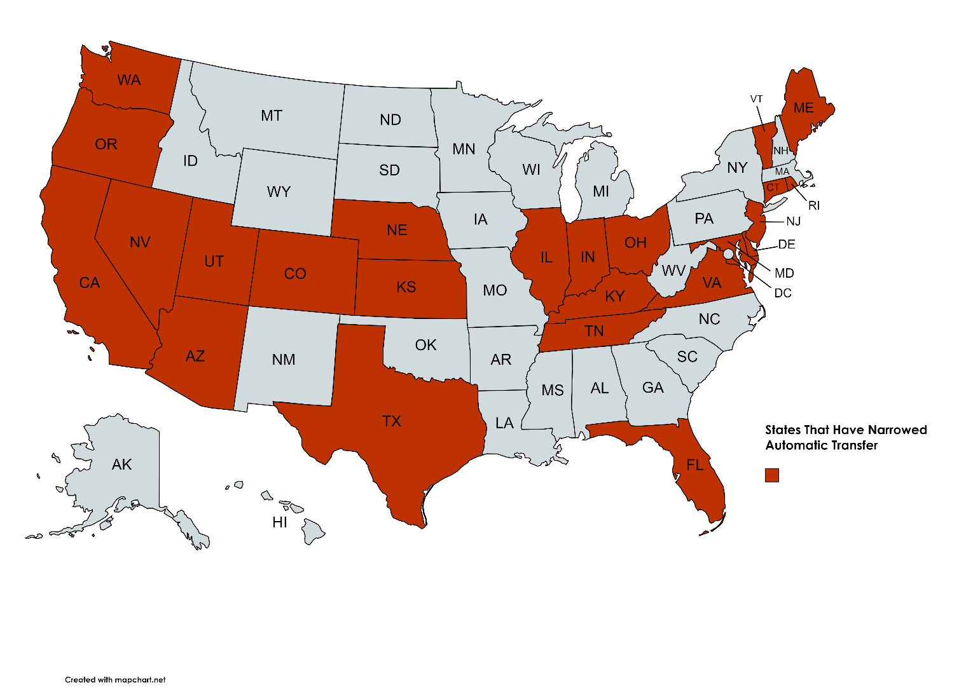
States Are Rapidly Reforming the Automatic Transfer Statutes
(26 states changed laws)
Notes:
As you can see, the reforms are happening across the US, not just in one section of the country.
Laws are bi-partisan
Republicans/conservatives are supporting based on court expediency, public safety and due process concerns

Slide 4
Effective Strategies to Treat Children Like Children
Striking one (or more) pathways into adult court
  CA, FL, IL, KS, KY, OR, RI, VT
Raising the Floor (removing youngest children from eligibility)
  CA, CO, CT, DE, IL, KS, NE, NJ, NV, TN, UT, VA
Narrowing eligible charges
  CO, CT, DE, IL, ME, NE
Expanding Reverse Waiver/Transfer
  AZ, IN, MD, NE, OH, TX, VT
Eliminate/Restricts Once an Adult
  VA, WA
Notes:
Research and best practice say that Judicial waiver is the most effected method to youth accountability; before 1980s only 7 states offered any auto transfer and it was extremely limited by age and offense. . While 45 states offer this as a possibility only 3/50k of kids in adult system get there through judicial waiver. There are currently 9 states that ONLY have judicial waiver as an option (this is the goal). California, Hawaii, Kansas, Oklahoma, Montana, Oregon, Tennessee, and Texas
RTF—half the states have no min age for some offenses, same is true in MD of capitol offenses. This is a problem. UN suggests NO ONE under 18 be charged as adults; many states are narrowing auto transfer to ages 15+; CA has best law in the country on this.
Elig Charges. Science does not back this approach at all---it runs counter to the entire mission of the JJ system, and never tells the whole story of what has happen. Under strong, developmentally appropriate and public safety responses—the WHOLE child, not the charge. In states as diverse as CA, DE, KY and UT—this includes charges that have gun possession…….DE, KY both limited guns; WA second degree robbery and assaults are diversionable

Slide 5
Overuse of Auto Transfer
States have shrunk their use of automatic transfer; we have gone from 15k down to under 10k per year (2015) over the past decade.
The Youth Justice system has the skills, staff and knowledge to handle these children.
Charge does not drive dangerousness or risk to public safety; must look at the whole child.
Starting kids in adult system and then returning them to juvenile exacerbates trauma and recidivism.
Only 9 states send more than 200 kids to the adult court every year.
Notes:
9 states include:
AL, AZ FL, IA, IN MD, NJ OH, PA. (FL, NJ have changed laws already, PA, IN are in study sessions to do more.

Slide 6
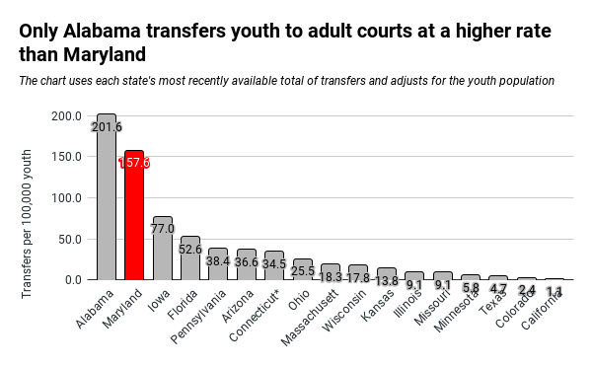
NATIONAL RATES OF TRANSFER

Slide 7
District Attorney’s Are beginning to Change Practice
Report of the U.S. Attorney Generals National Task Force on Children Exposed to Violence (2012):
  6.9 Whenever possible, prosecute young offenders in the juvenile justice system instead of transferring their cases to adult courts.
National Juvenile Prosecution Standards of NDAA (2016):
  4-11.7 Transfer to Criminal Court The transfer of cases to criminal court should be reserved for the most serious, violent, and chronic offenders. Prosecutors should make transfer decisions on a case-by-case basis and take into account the individual factors of each case including, among other factors, the gravity and violent nature of the current alleged offense, the record of previous delinquent behavior of the juvenile charged, and the availability of adequate treatment, services and dispositional alternatives in juvenile court.
Fair & Just Prosecution:
  Treat kids like kids. It’s not only good common sense, but good public policy (2019)
  100 Legal Scholars Support Treating Children Like Children (2019)

